Slide 1
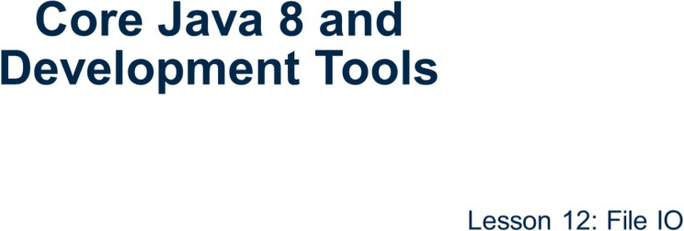
Core Java 8 and Development Tools
File IO

Slide 2
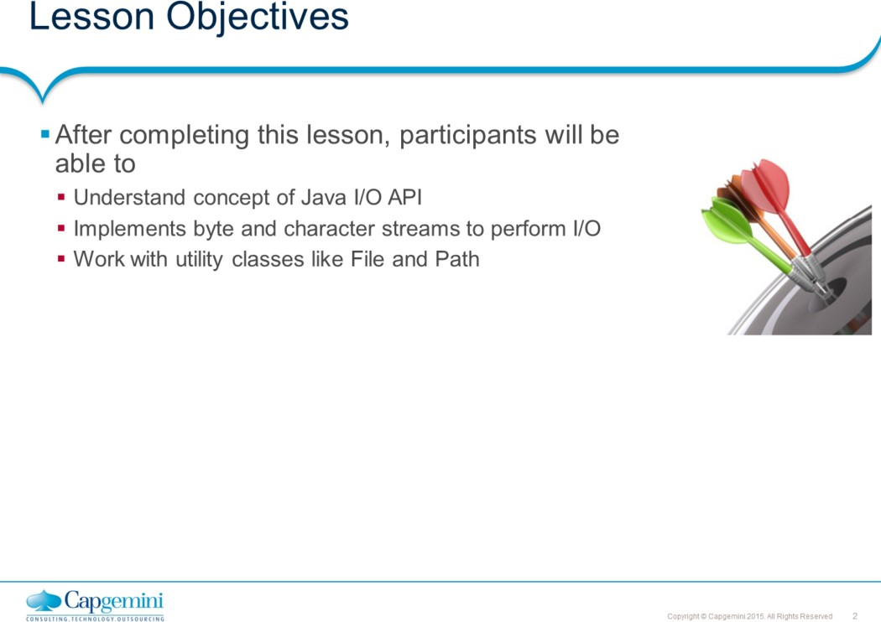
Core Java 8 and Development Tools
File IO
This lesson covers the Java platform classes used for basic I/O. It focuses primarily on I/O Streams, a powerful concept that greatly simplifies I/O operations. The lesson also looks at serialization, which lets a program write whole objects out to streams and read them back again. Most of the classes covered are in the java.io package.
Lesson outline:
13.1: Overview of I/O Streams 13.2: Types of Streams
13.3: The Byte-stream I/O hierarchy 13.4: Character Stream Hierarchy 13.5: Buffered Stream
13.6: The File class 13.7: Exploring NIO
: Object Stream
: Best Practices

Slide 3
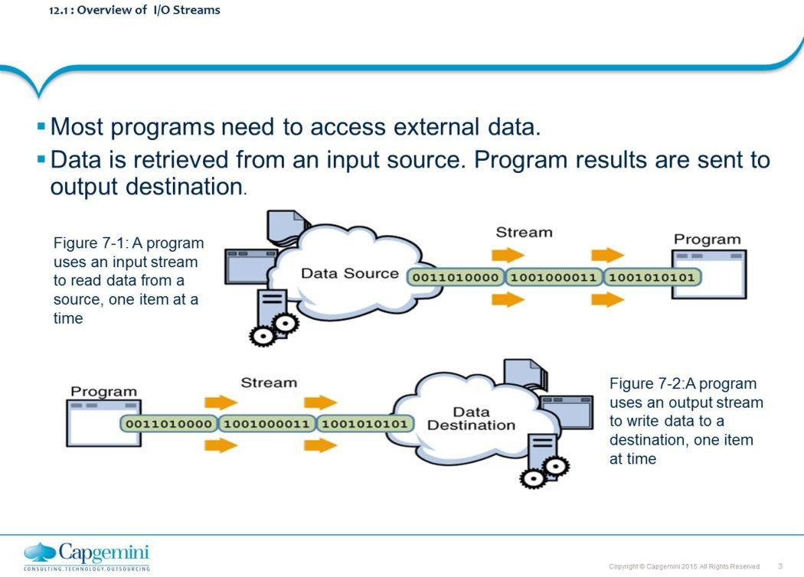
Core Java 8 and Development Tools
File IO
Most programs need to use data. To read some data, a Java program opens a stream to a data source, such as a file or remote socket, and reads the information serially. To write some data, a program opens a stream to a data source and writes to it in a serial fashion.
Whether you are reading from a file or from a socket, the concept of serially reading from, and writing to different data sources is the same.
The java.io package provides an extensive library of classes dealing with input and output. Each class has a variety of member variables & methods. java.io is layered. i.e. it does not attempt to put too much capability into one class. Instead, you can get the features you want, by layering (chaining streams) one class over another.

Slide 4
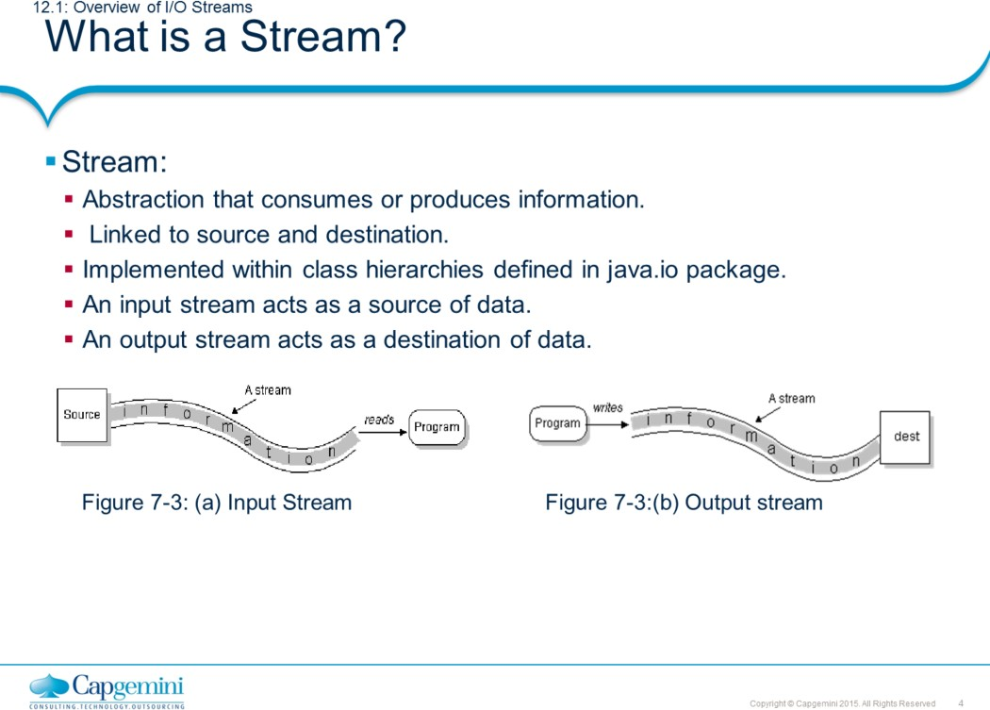
Core Java 8 and Development Tools
File IO
The source and destination of data for a java program can be anything – a network connection, local files, memory buffer etc. All are handled in the same way using streams. Streams implement sequential access of data. Java implements streams within class hierarchies defined in the java.io package.
An input stream is an object that an application can use, to read a sequence of data. An output stream is an object that an application can use to write a sequence of data.
An input stream acts as a source of data, and an output stream acts as a destination of data.
Some streams simply pass on data; others manipulate and transform the data in useful ways.

Slide 5
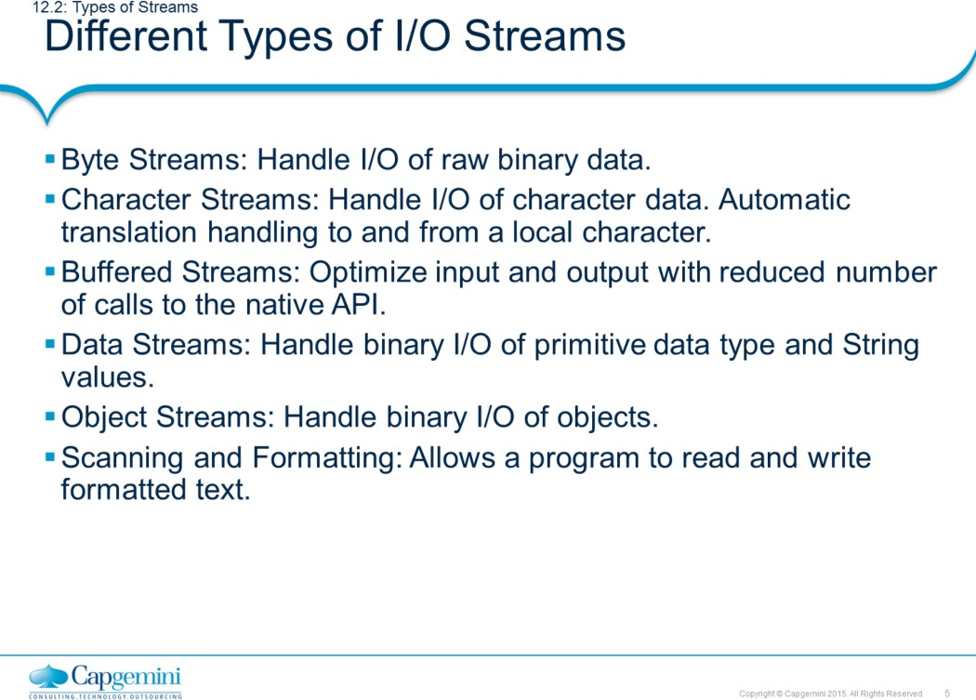
Core Java 8 and Development Tools
File IO
There are different types of I/O (Input/Output) Streams:
Byte Streams: They provide a convenient means for handling input and output of bytes. Programs use byte streams to perform input and output of 8- bit bytes. All byte stream classes descend from InputStream and OutputStream class.
Character streams: They provide a convenient means for handling input and output of characters. They use Unicode and, therefore, can be internationalized.
Buffered Streams: Buffered input streams read data from a memory area known as a buffer; the native input API is called only when the buffer is empty. Similarly, buffered output streams write data to a buffer, and the native output API is called only when the buffer is full.
Data Streams: Data streams support binary I/O of primitive data type values (boolean, char, byte, short, int, long, float, and double) as well as String values.
Object Streams: Just as data streams support I/O of primitive data types, object streams support I/O of objects.
Scanning and Formatting: It allows a program to read and write
formatted text.

Slide 6
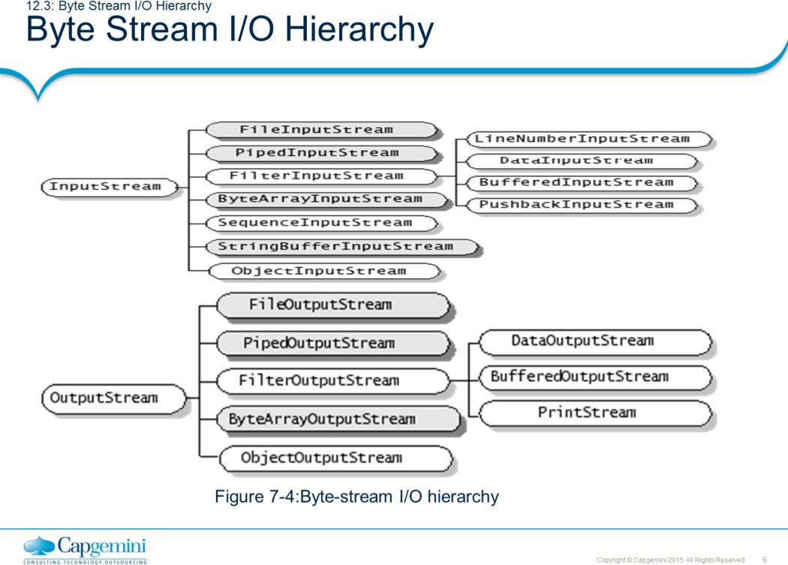
Core Java 8 and Development Tools
File IO
At the top of the hierarchy are two abstract classes: InputStream and OutputStream.
Each of these abstract classes serves as base class for all other concretely implemented I/O classes. Each of the abstract classes defines several key methods that the other stream classes implement.

Slide 7
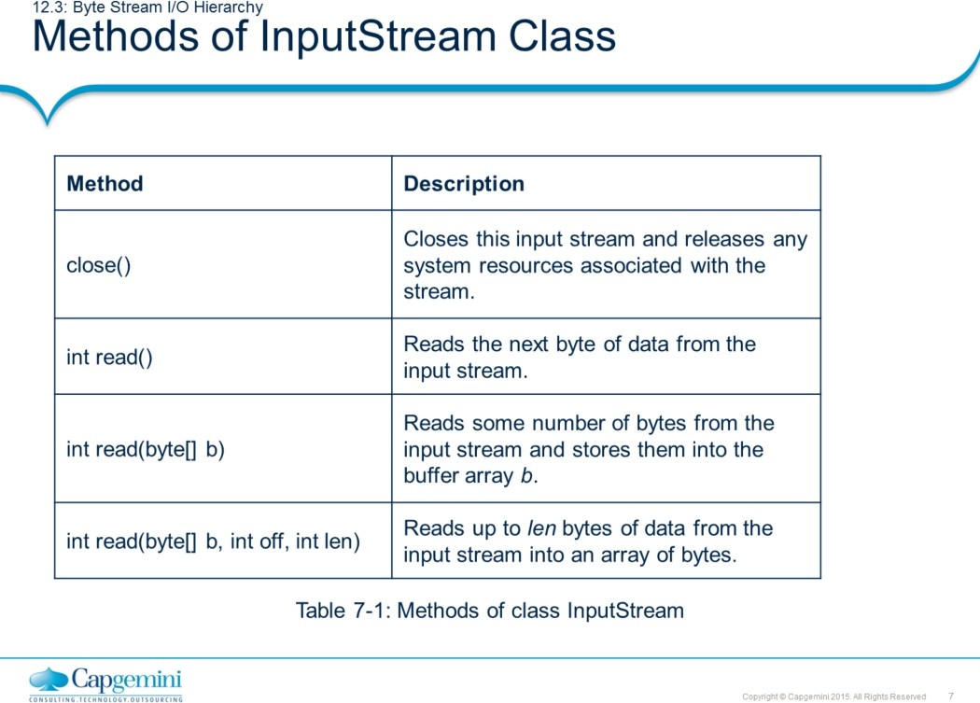
Core Java 8 and Development Tools
File IO
All byte stream classes are descended from InputStream and OutputStream.
Note: Refer to Java documentation for more methods.

Slide 8
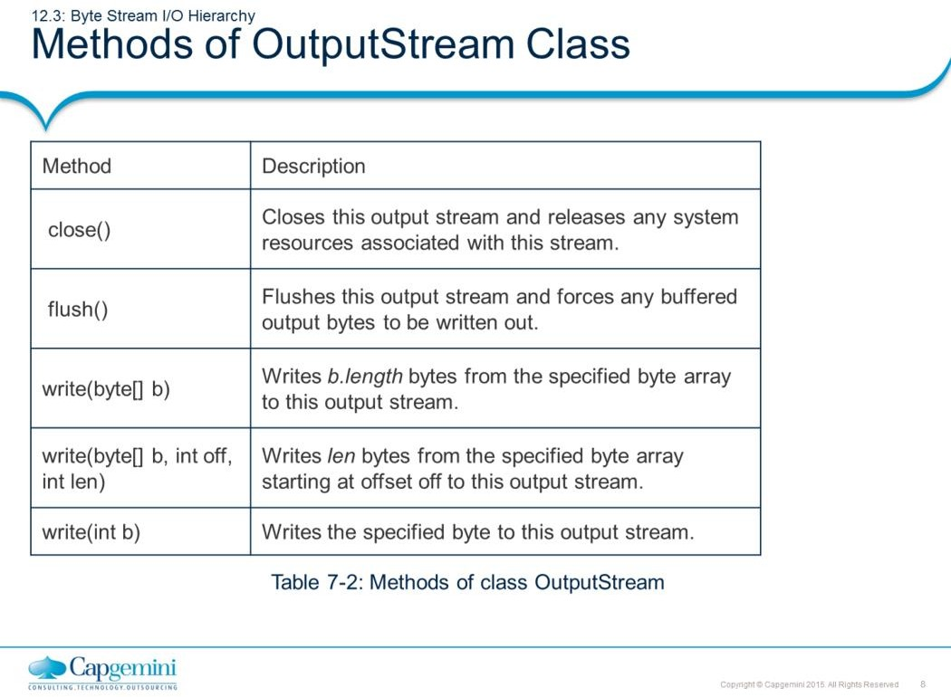
Core Java 8 and Development Tools
File IO
Closing an output stream automatically flushes the stream, meaning that data in its internal buffer is written out. An output stream can also be manually flushed by calling the flush() method.
Note: Refer to Java documentation for more methods.

Slide 9
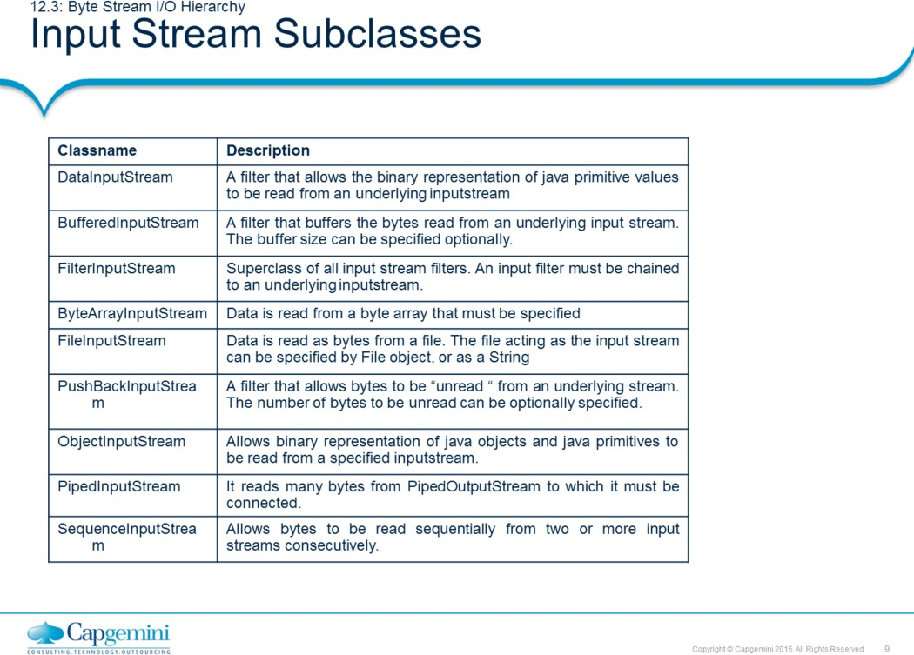
Core Java 8 and Development Tools
File IO
The InputStream class allows several classes to derive from it. Some of these classes are described in the table above.
Note: All of the above mentioned classes have corresponding output stream classes except SequenceInputStream.

Slide 10
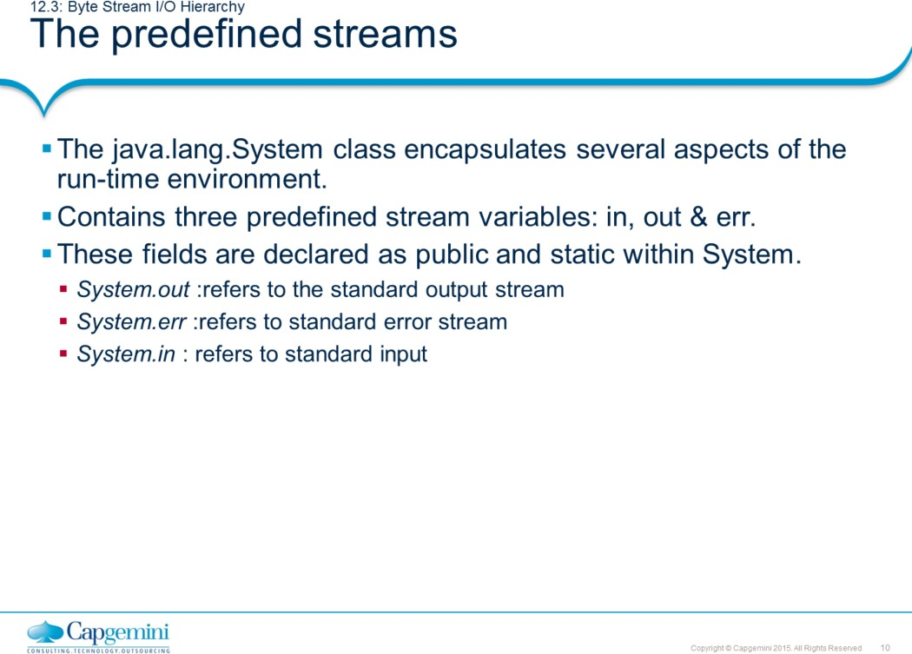
Core Java 8 and Development Tools
File IO
System.out refers to the standard output stream and System.err refers to standard error stream (Both, by default, the console). These are objects of type PrintStream class.
System.in refers to standard input (keyboard by default). This is an object of the InputStream class.

Slide 11
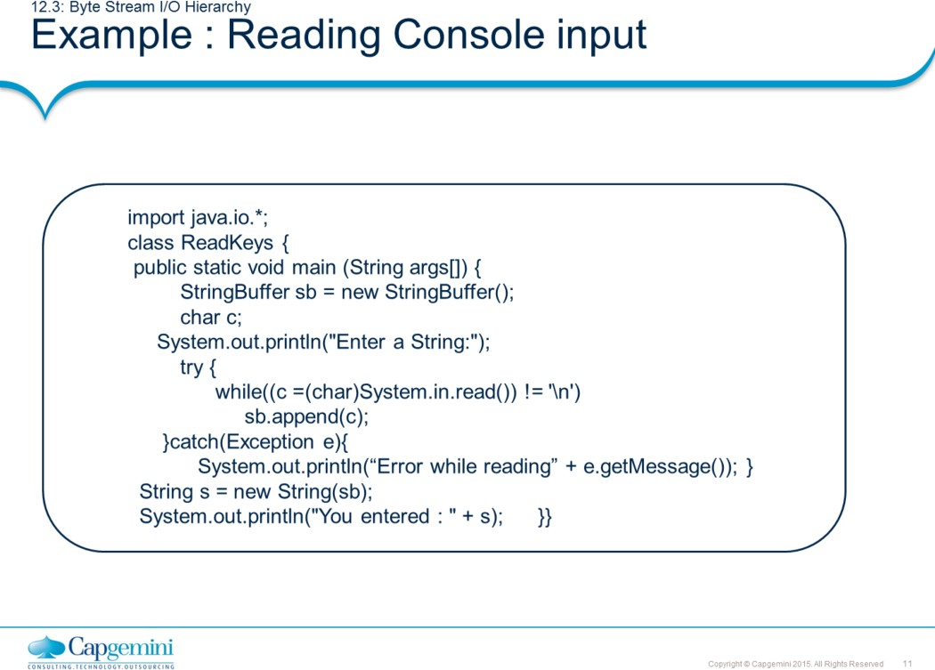
Core Java 8 and Development Tools
File IO
In Java, console input is accomplished by reading from System.in. In the above example, read() methods reads a byte from the input stream (here, the keyboard), and returns an integer. Therefore, casting to char type need to be done.

Slide 12
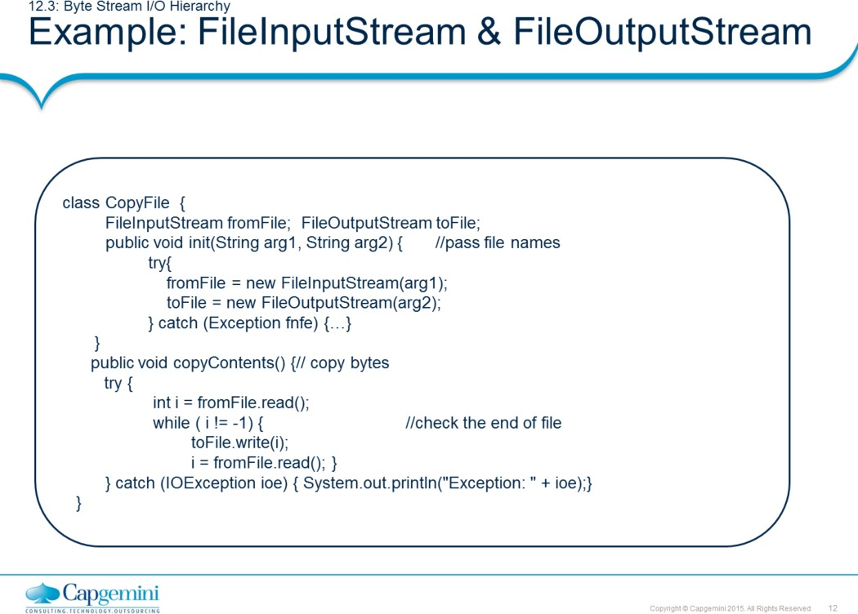
Core Java 8 and Development Tools
File IO
The remainder of the code follows:
public void closeFiles() { try{
fromFile.close(); toFile.close();
} catch (IOException ioe){
//close the file
System.out.println("Exception: " + ioe);
}
}
public static void main(String[] args){ CopyFile c1 = new CopyFile(); c1.init(args[0], args[1]); c1.copyContents(); c1.closeFiles();
} }
The FileInputStream and FileOutputStream classes define byte input and output streams that are connected to files. Data can only be read or written as a sequence of bytes. The above example demonstrates the use of File InputStream and FileOutputStream.

Slide 13
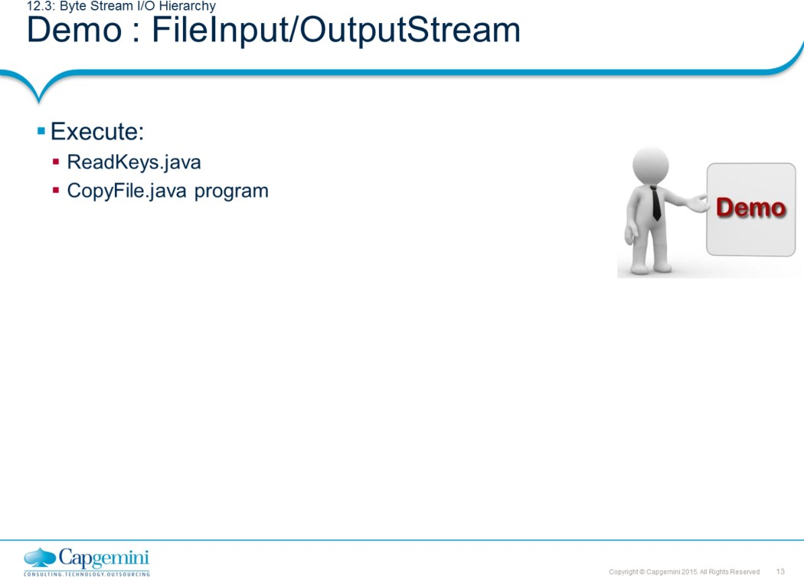
Core Java 8 and Development Tools
File IO

Slide 14
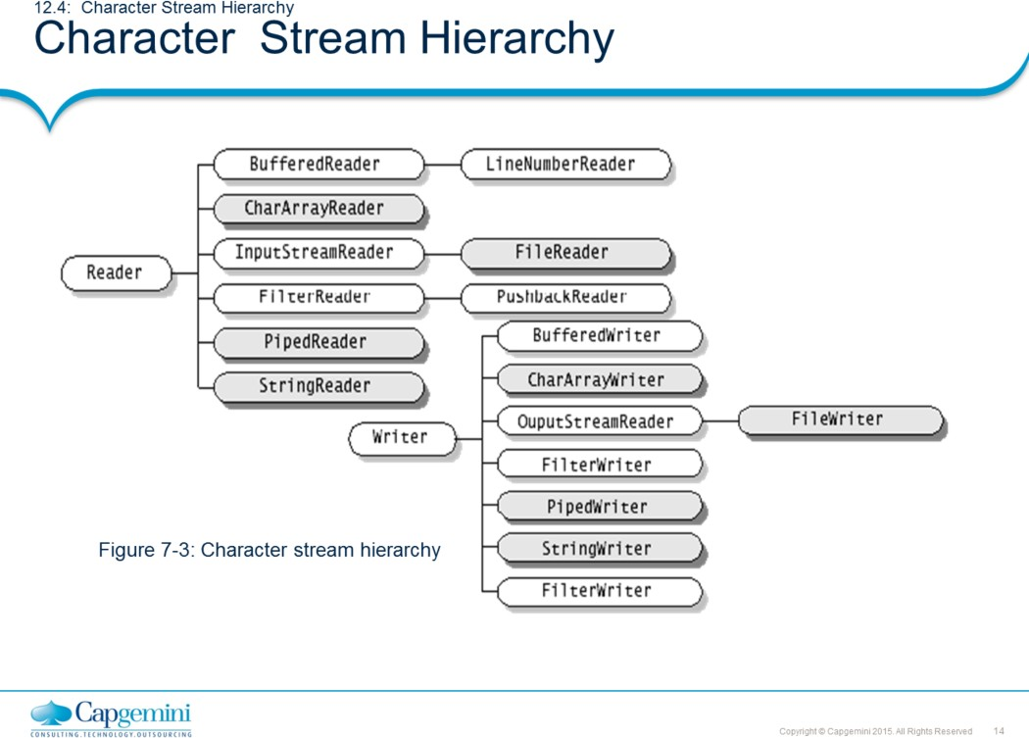
Core Java 8 and Development Tools
File IO
The byte stream classes support only 8-bit byte streams and doesn’t handle 16-bit Unicode characters well. A character encoding is a scheme for representing characters. Java represents characters internally in the 16-bit Unicode character encoding, but the host platform might use different character encoding.
The abstract classes Reader and Writer are the roots of the inheritance hierarchies for streams that read and write Unicode characters using a specific character encoding.
A reader is an input character stream that reads a sequence of Unicode characters, and a writer is an output character stream that writes a sequence of Unicode characters.

Slide 15
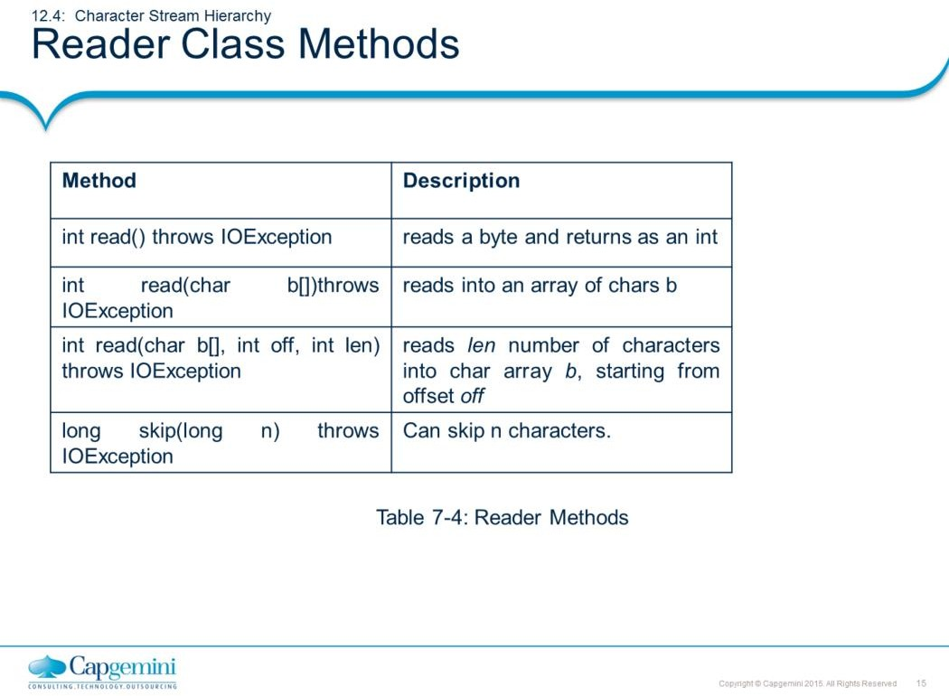
Core Java 8 and Development Tools
File IO
Note: Refer to Java documentation for more methods.

Slide 16
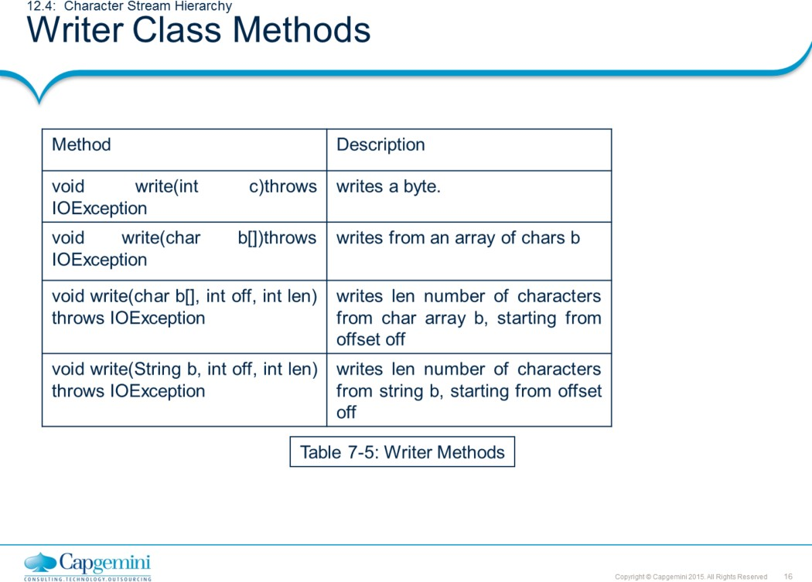
Core Java 8 and Development Tools
File IO
Note: Refer to Java documentation for more methods.

Slide 17
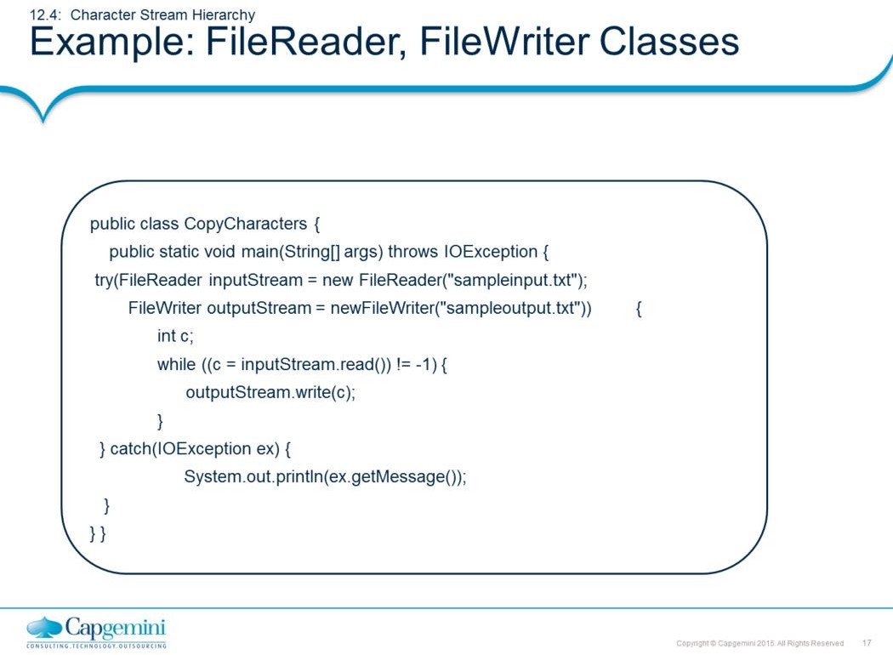
Core Java 8 and Development Tools
File IO

Slide 18
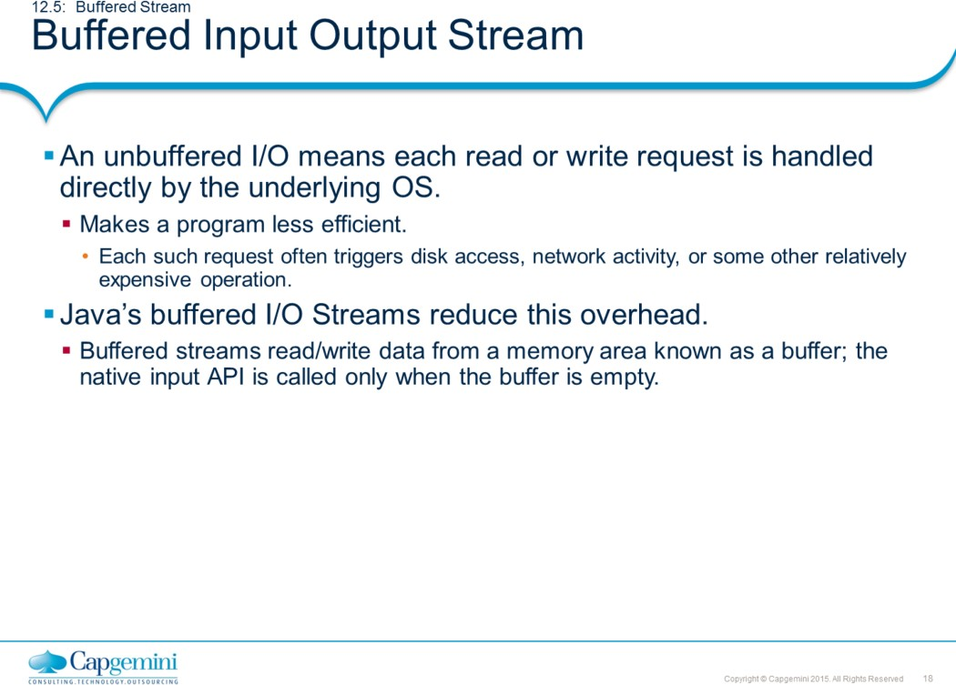
Core Java 8 and Development Tools
File IO

Slide 19
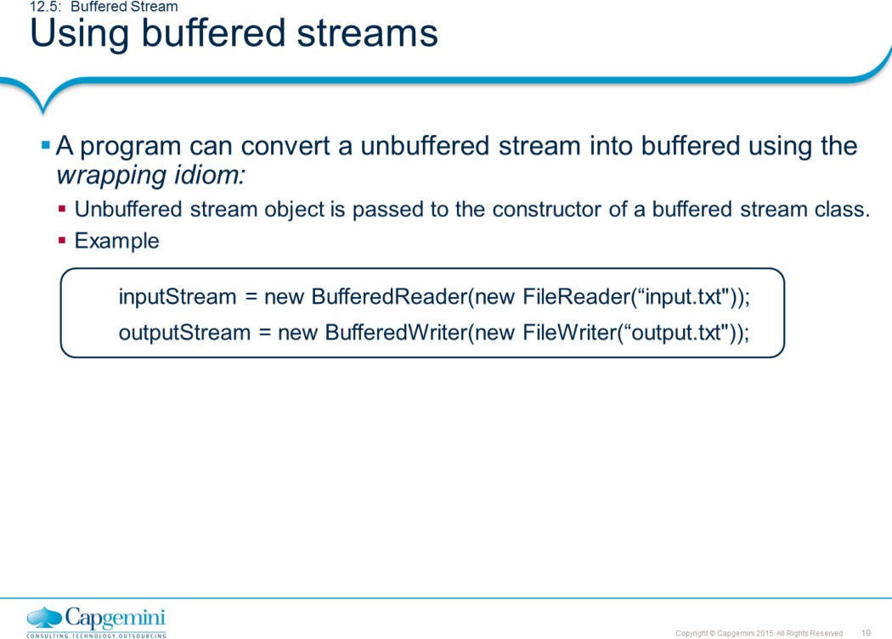
Core Java 8 and Development Tools
File IO
There are four buffered stream classes used to wrap unbuffered streams.
BufferedInputStream and BufferedOutputStream - create buffered
byte streams.
BufferedReader and BufferedWriter - create buffered character
streams.
Flushing Buffered Streams
It often makes sense to write out a buffer at critical points, without
waiting for it to fill. This is known as flushing the buffer.
Some buffered output classes support autoflush, specified by an optional constructor argument. When autoflush is enabled, certain key events cause the buffer to be flushed. For example, an autoflush PrintWriter object flushes the buffer on every invocation of println or format.
To flush a stream manually, invoke its flush() method. The flush() method is valid on any output stream, but has no effect unless the stream is buffered.

Slide 20
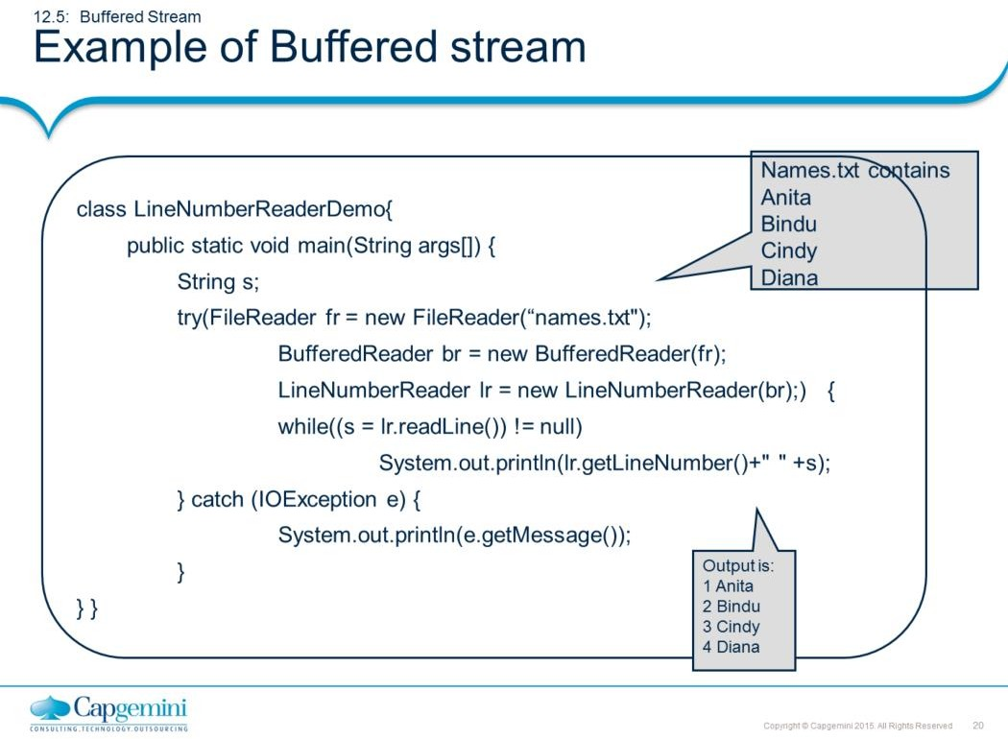
Core Java 8 and Development Tools
File IO

Slide 21
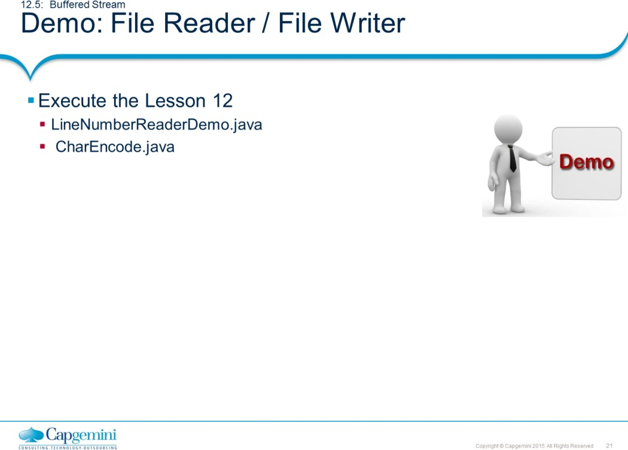
Core Java 8 and Development Tools
File IO

Slide 22
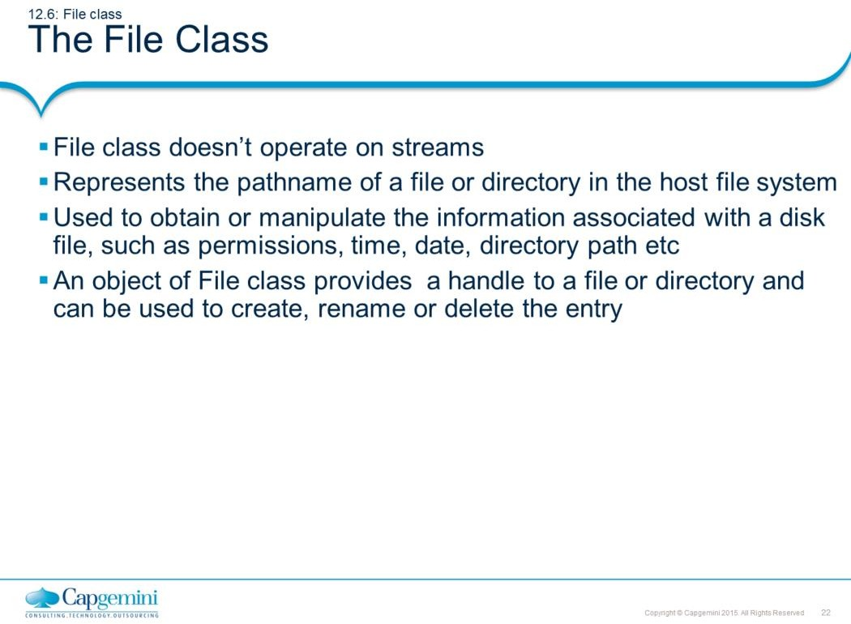
Core Java 8 and Development Tools
File IO
Support for File/Directory Operations are provided by java.io.File. This class makes it easier to write platform-independent code that examines and manipulates files.
Provides methods
To obtain basic information about the file/directory To Create / Delete Files and Directories

Slide 23
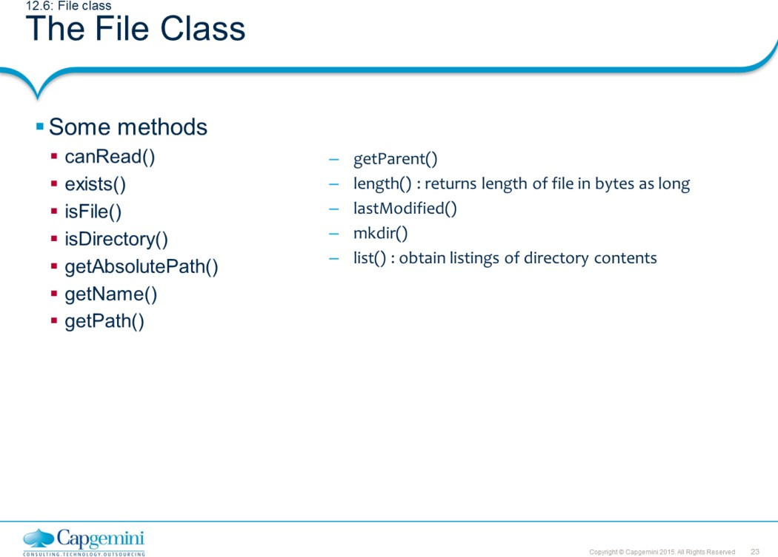
Core Java 8 and Development Tools
File IO

Slide 24
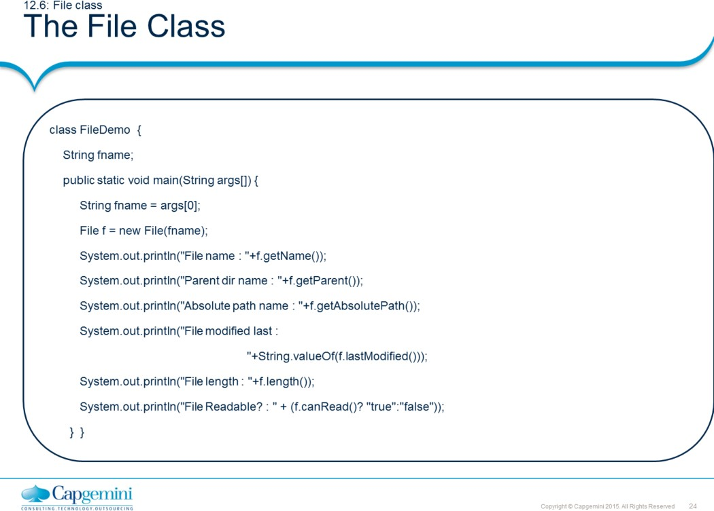
Core Java 8 and Development Tools
File IO
Output :
File name : books.xml Parent directory name :
null
Absolute path name : D:\G-drive contents\java-demo\day5(filesIO)\demo\file handling\books.xml
File modified last on : 0 File length : 0
File Readable? : false

Slide 25
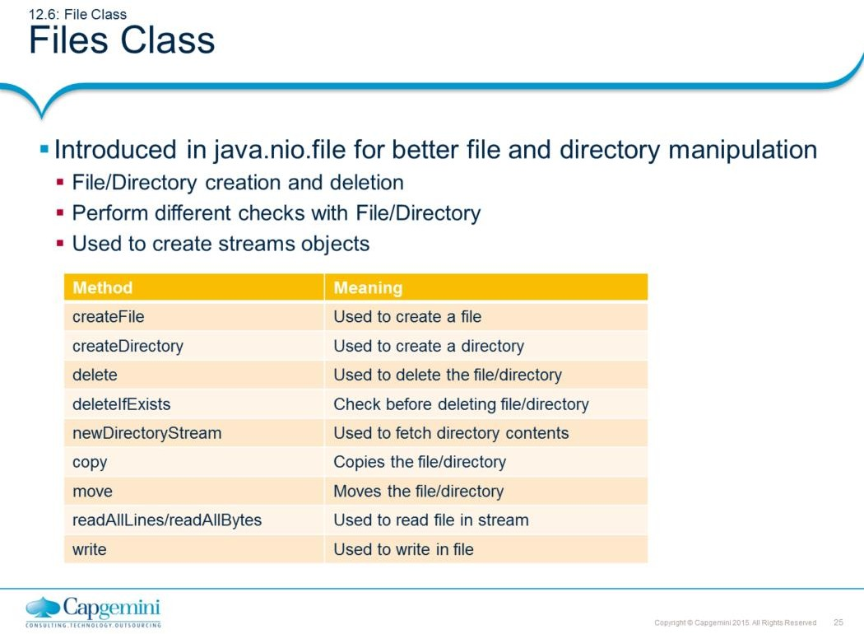
Core Java 8 and Development Tools
File IO
Files class contains lots of static methods to perform manipulation on files and directories. It also helps to retrieve streams from file/directory for reading or writing. The code snippet shown below is used to list all contents of directory.
Path javaHome= Paths.get("C:/Program Files/Java/jdk1.8.0_25"); DirectoryStream<Path> contents = Files.newDirectoryStream(javaHome); for(Path content: contents) {
System.out.println(content.getFileName());
}
contents.close();
Below listed snippet shows how to read the contents of a textual file with ease.
Path file = Paths.get("D:/output.txt"); List<String> lines = Files.readAllLines(file); for(String line:lines) {
System.out.println(line);
}
System.out.println("End of File....");

Slide 26
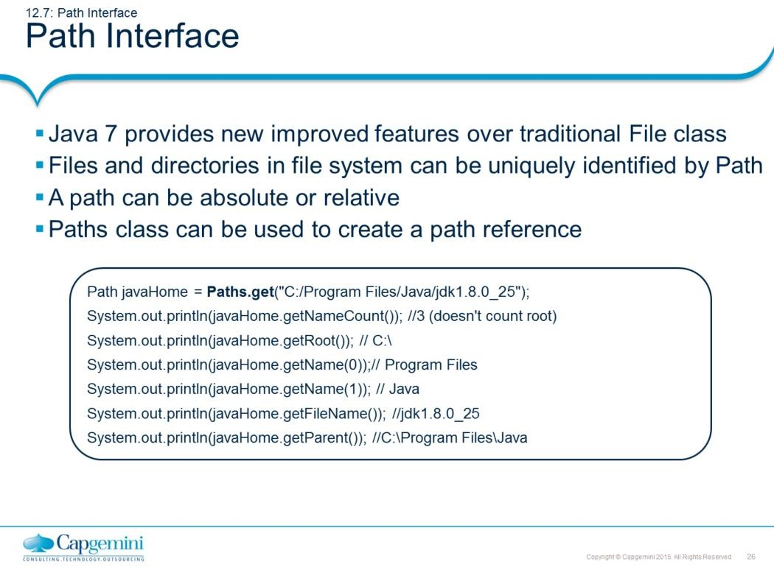
Core Java 8 and Development Tools
File IO
Path interface introduced in java.nio.file package to support better file handling and to overcome few drawbacks of traditional File class.
Path instance is used as reference to File or Directories as either relative or absolute path. Paths class is used to create a non-existance reference to file or directory. It means, creating reference of Path doesn’t create new file or directory.
Few methods of Path interface are shown in slide, the getNameCount() method is used to return count of path parts. Individual part of path can be retrieved by using getName(index); the index start from 0.
The getFileName() returns last part of path and getParent() returns parent path.

Slide 27
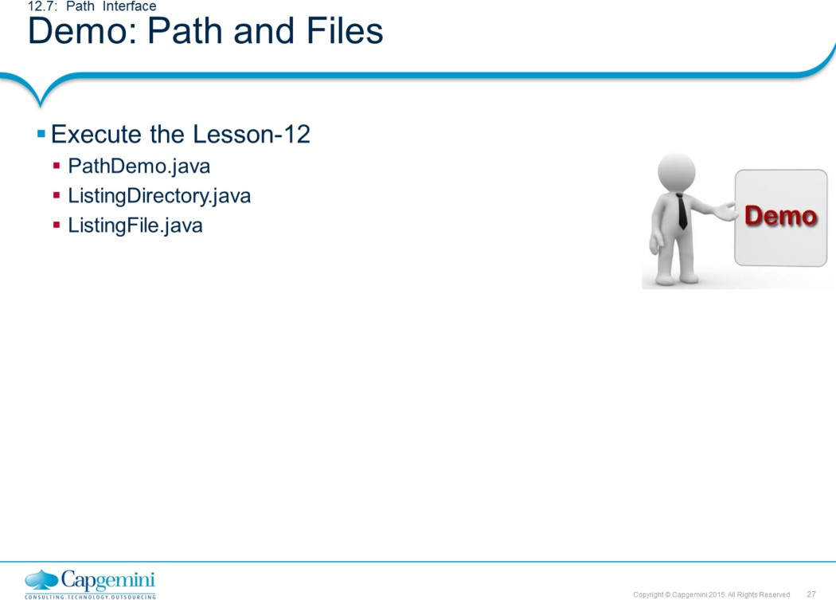
Core Java 8 and Development Tools
File IO

Slide 28
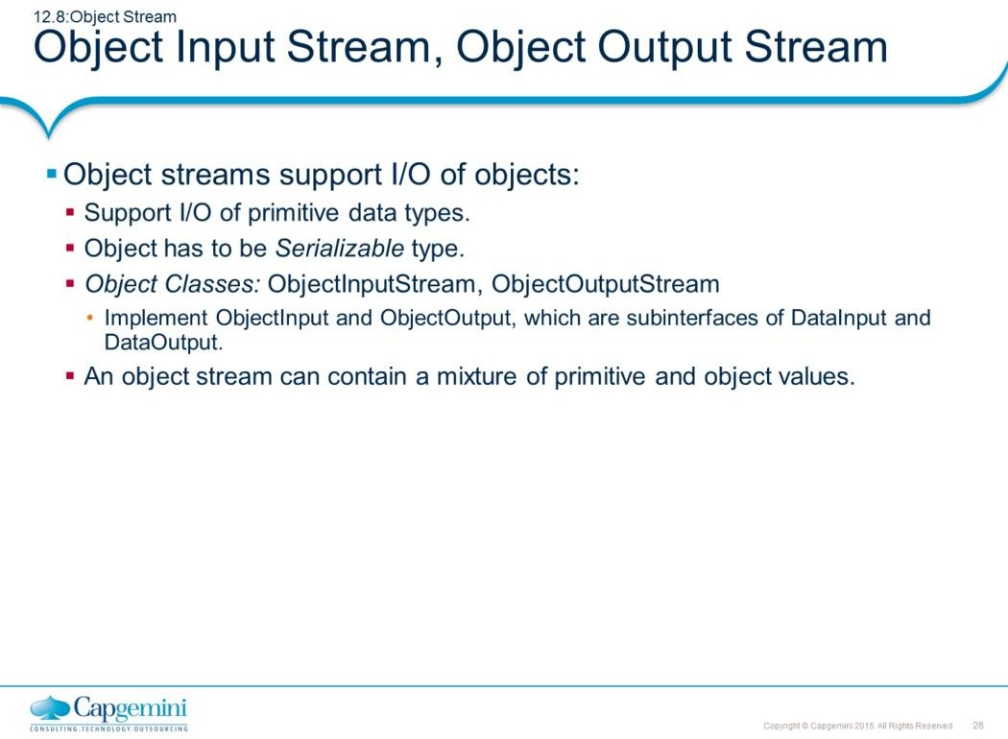
Core Java 8 and Development Tools
File IO
Only objects that support the java.io.Serializable or java.io.Externalizable interface can be read from streams.
The method readObject is used to read an object from the stream. Java's safe casting should be used to get the desired type. In Java, strings and arrays are objects and are treated as objects during serialization. When read they need to be cast to the expected type.
Primitive data types can be read from the stream using the appropriate method on DataInput.

Slide 29
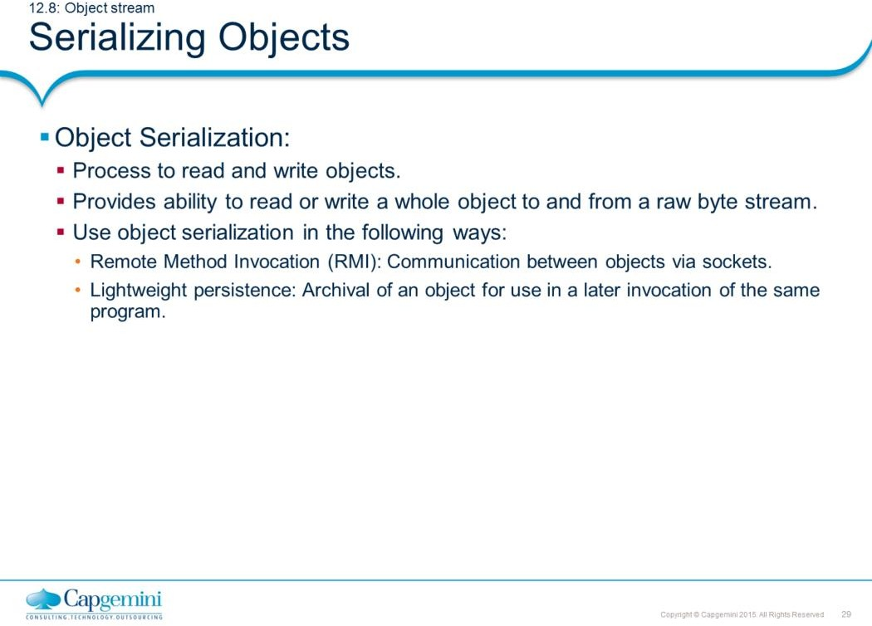
Core Java 8 and Development Tools
File IO
Object Serialization allows an object to be transformed into a sequence of bytes that can be later re-created (deserialized) into an original object.
Java provides this facility through ObjectInput and ObjectOutput interfaces, which allow the reading and writing of objects from and to streams. These interfaces extend DataInput and DataOutput respectively
The concrete implementation of ObjectOutput and ObjectInput interfaces is provided in ObjectOutputStream and ObjectInputStream classes respectively. These two interfaces have the following methods:
final void writeObject(Object obj) throws IOException.
final Object readObject() throws IOException, ClassNotFoundException
The writeObject() method can be used to write any object to a stream, including strings and arrays, as long as an object supports java.io.Serializable interface, which is a marker interface with no methods.
Serializing an object requires only that it meets one of two criteria. The class must either implement the Serializable interface (java.io.Serializable) which has no methods that you need to write or the class must implement the Externalizable interface which defines two methods. As long as you do not have any special requirements, making a serializable is as simple as adding the ``implements Serializable'' clause.

Slide 30
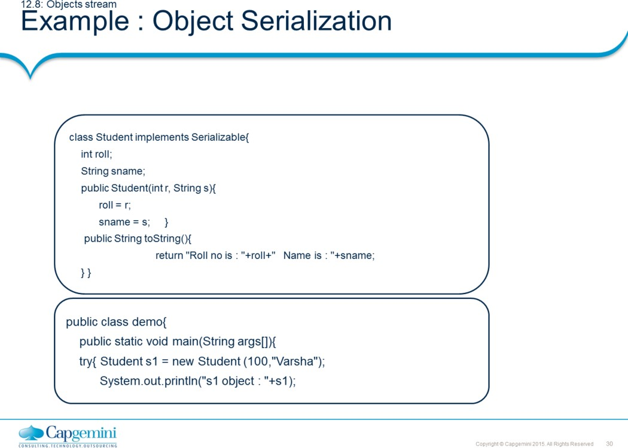
Core Java 8 and Development Tools
File IO

Slide 31
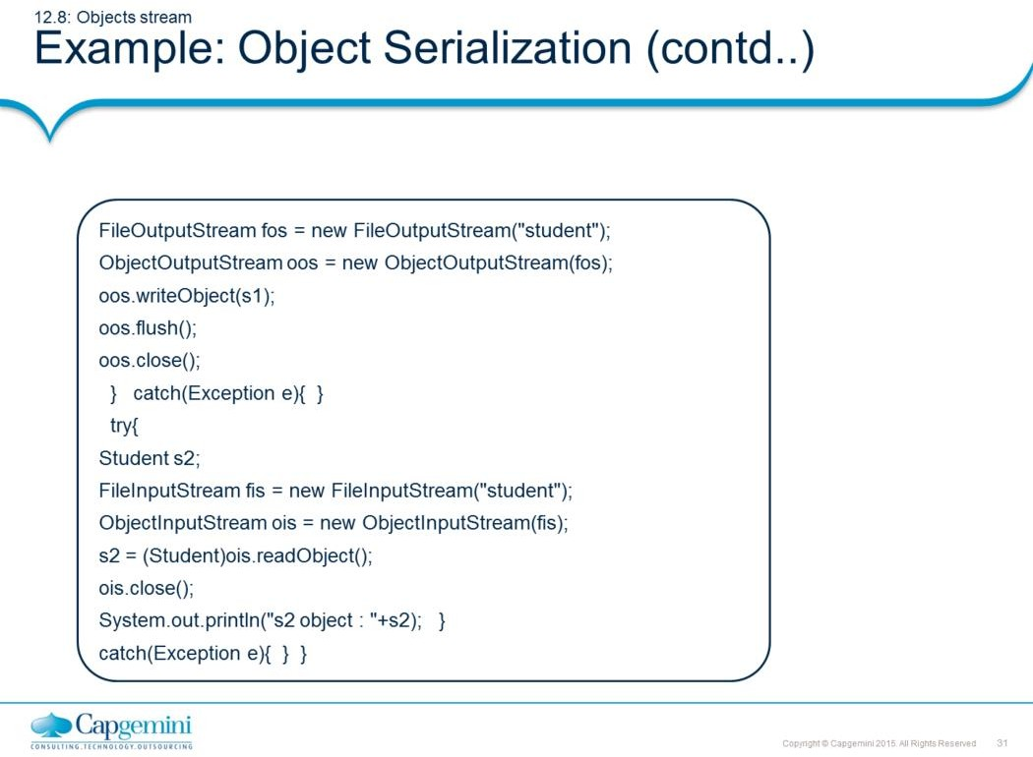
Core Java 8 and Development Tools
File IO
Output :
s1 object : Roll no is : 100 s2 object : Roll no is : 100
Name is : Varsha Name is : Varsha

Slide 32
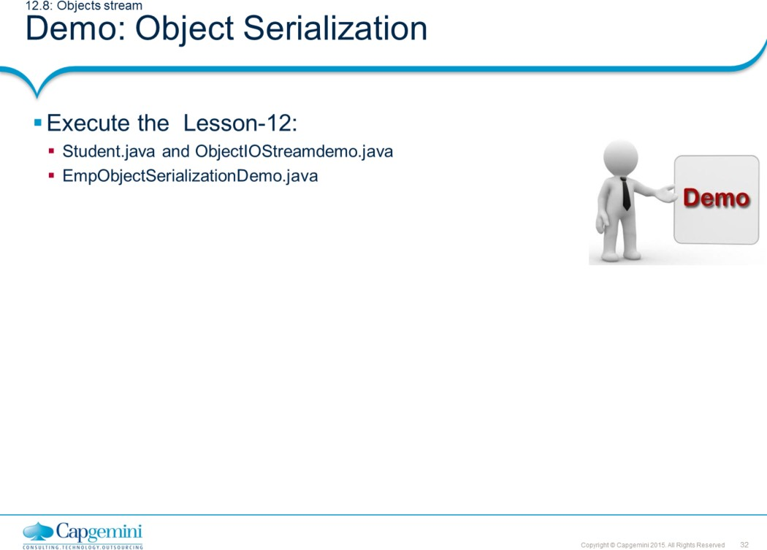
Core Java 8 and Development Tools
File IO

Slide 33
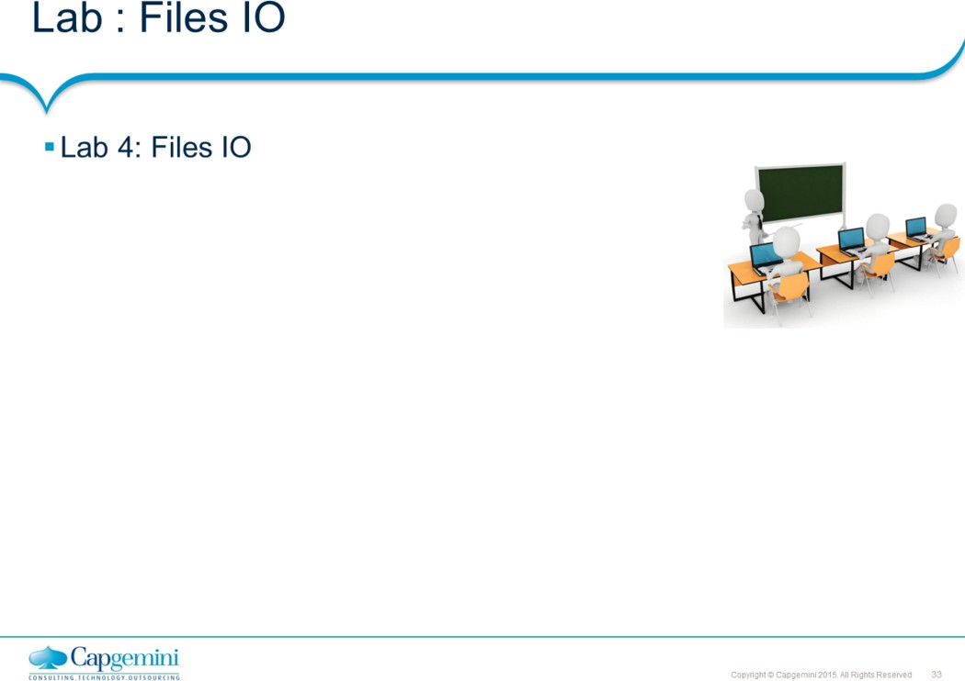
Core Java 8 and Development Tools
File IO

Slide 34
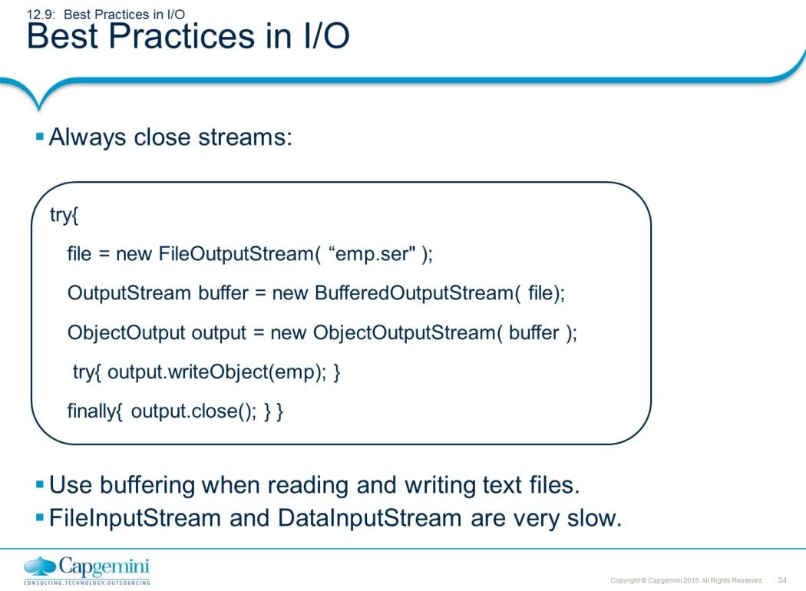
Core Java 8 and Development Tools
File IO
Always close streams
Streams represent resources which you must always clean up explicitly, by calling the close method. Some java.io classes (apparently just the output classes) include a flush method. When a close method is called on a such a class, it automatically performs a flush. There is no need to explicitly call flush before calling close.
One stream is chained to another by passing it to the constructor of some second stream. When this second stream is closed, then it automatically closes the original underlying stream as well.
If multiple streams are chained together, then closing the one which was the last to be constructed, and is thus at the highest level of abstraction, will automatically close all the underlying streams. So, one only has to call close on one stream in order to close (and flush, if applicable) an entire series of related streams.
Reading and Writing text files : When reading and writing text files: it is almost always a good idea to use buffering (default size is 8K)
Unbuffered input and output classes operate only on one byte at a time. Using a buffer will often increase performance by large factors.
FileInputStream & DataInputStream is very slow : since they call read() for every character. Use FileReader and BufferedReader instead. Reader objects use Large Buffer. Unbuffered input/output classes operate only on one byte at a time. Using a buffer will often increase performance by large factors.

Slide 35
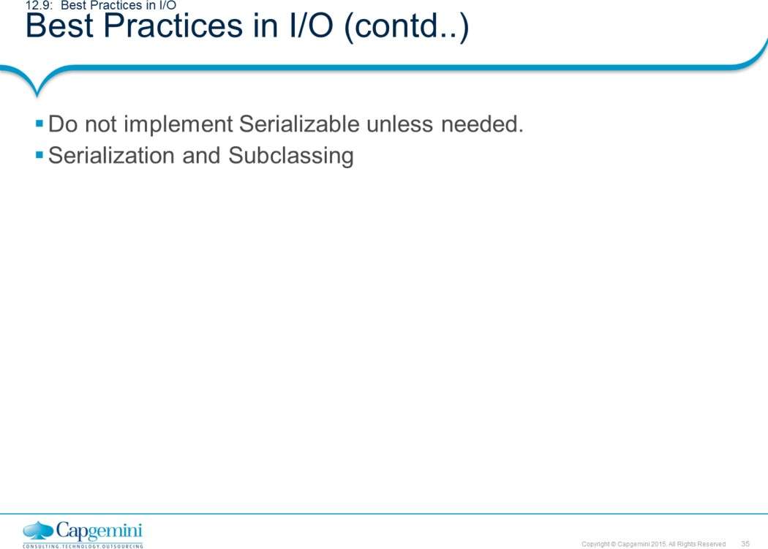
Core Java 8 and Development Tools
File IO
Implementing Serializable
Do not implement Serializable lightly, since it restricts future flexibility, and publicly exposes class implementation details which are usually private.
Serialization and Subclassing
Interfaces and classes designed for inheritance should rarely implement Serializable, since this would force a significant and (often unwanted) task on their implementors and subclasses.
However, even though most abstract classes do not implement Serializable, they may still need to allow their subclasses to do so, if desired.
There are two cases. If the abstract class has no state, then it can simply provide a no-argument constructor to its subclasses. If the abstract class has state, however, then there is more work to be done

Slide 36
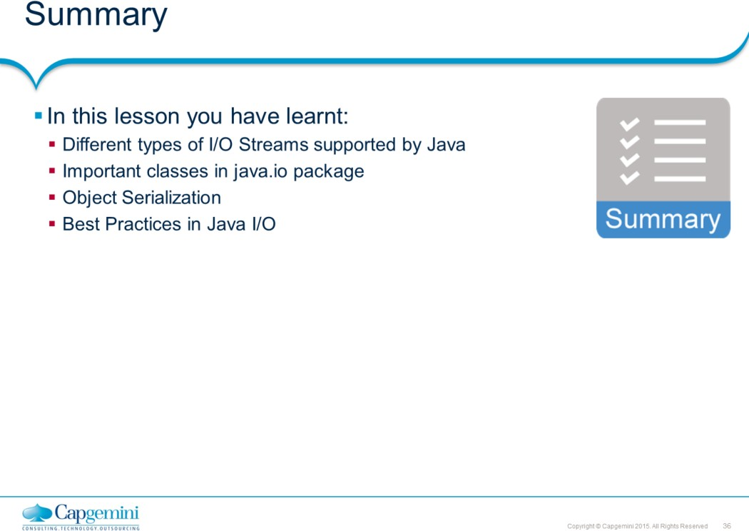
Core Java 8 and Development Tools
File IO

Slide 37
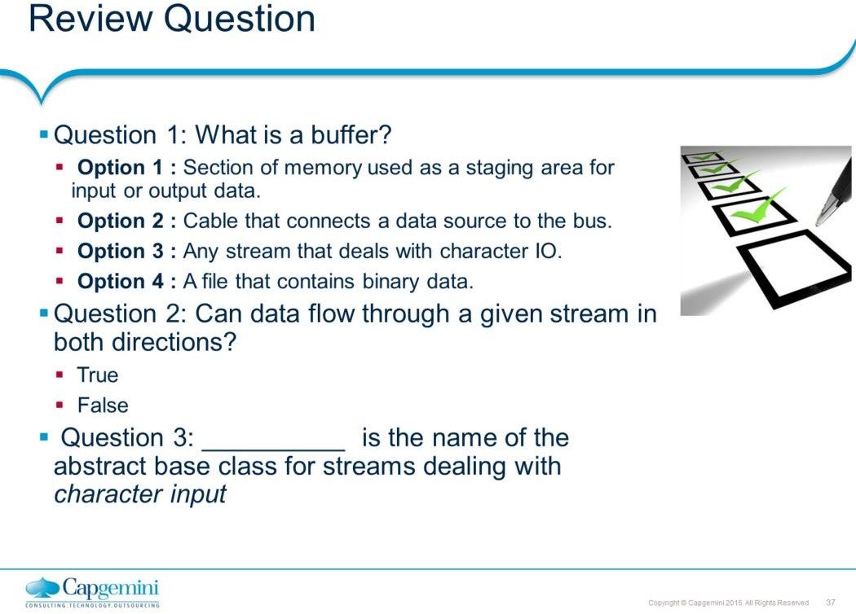
Core Java 8 and Development Tools
File IO

